Slide 1

Incident Services : Impact Prediction
Presented By:
Ms. Shruti Bichkunde
Mentor:
Rajashekar

Slide 2

BUSINESS OBJECTIVE
An incident is an unplanned interruption to an IT Service or reduction in the quality of an IT Service. Failure of a service, service degradation, failure of a server etc. are all incidents. These incidents all affect the service delivery to the customer or business.
Business Impact decides the level of priority of an Incident. The impact is often based on how Service Levels will be affected in a business of the company.
The business Objective for this Project is to predict the impact of the incident raised by the customer.

Slide 3
Project Architecture/Project Flow

Slide 4
DATA COLLECTION
EDA
MODEL BUILDING
DEPLOYMENT
DATA
COLLECTION
DATA
VISUALIZATION
TRAIN TEST SPLIT
FLASK/DJANGO
FRAMEWORK
DATA
CLEANING
MODEL
BUILDING
DEPLOY ON LOCAL SYSTEM
BUSINESS
OBJECTIVE
DATA
PRE-PROCESSING
CHOOSE BEST MODEL
With High
1] Accuracy
2] Precision
3] Recall
4] F1 score
FINAL DEPLOYMENT ON CLOUD PLATFORM
FEATURE
ENGINEERING

Slide 5
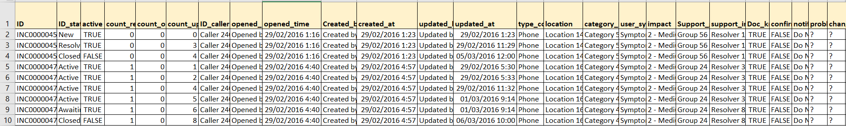
DataSet Details
The dataset is having incidents raised by customers. Which contains an event log of an incident management process extracted from a service desk platform of an IT company.
Dataset has more than 1+ lakh Incidents and some of the data was anonymized for privacy.
It comprises of 25 columns in total out of which 24 are Independent Variables and 'impact' is Target Variable.

Slide 6
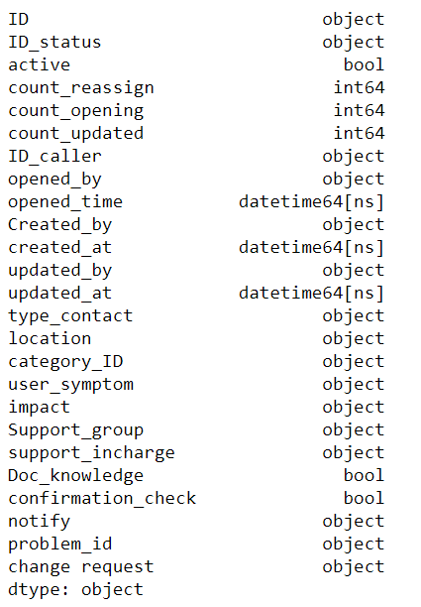
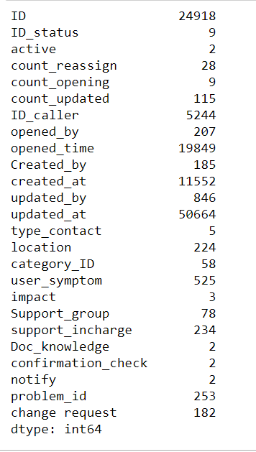
Data Types and Unique Values

Slide 7
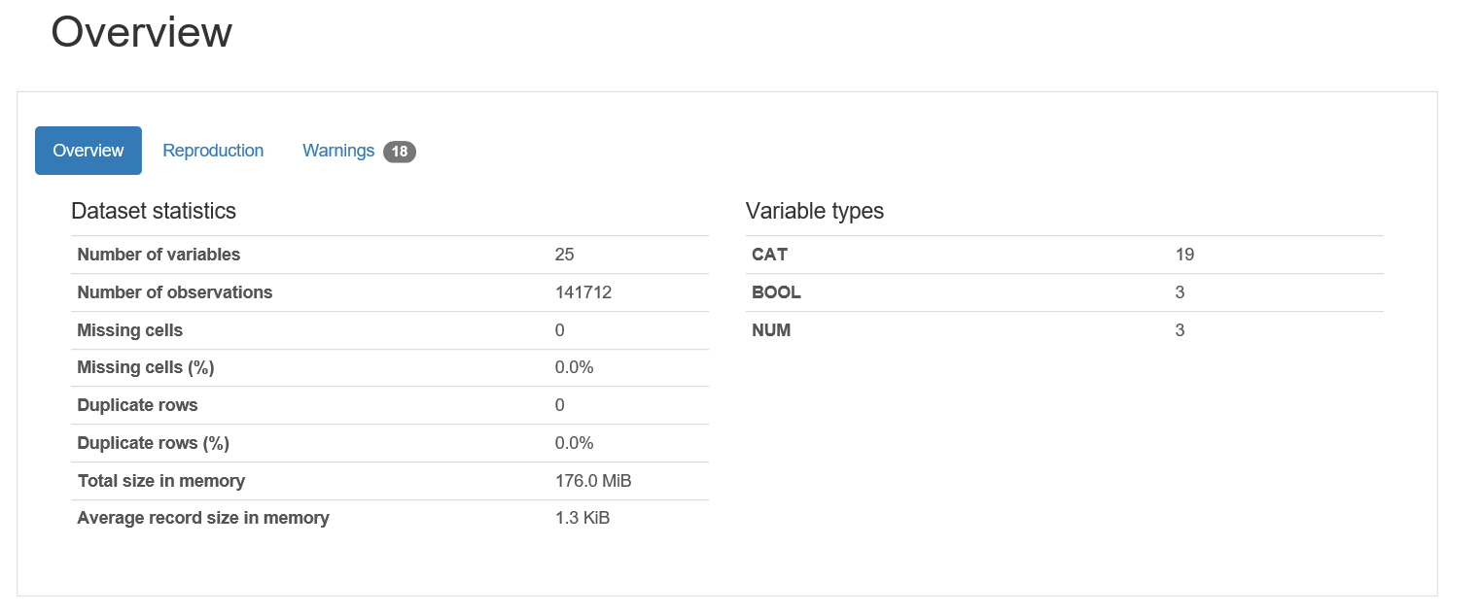
Data Visualization

Slide 8
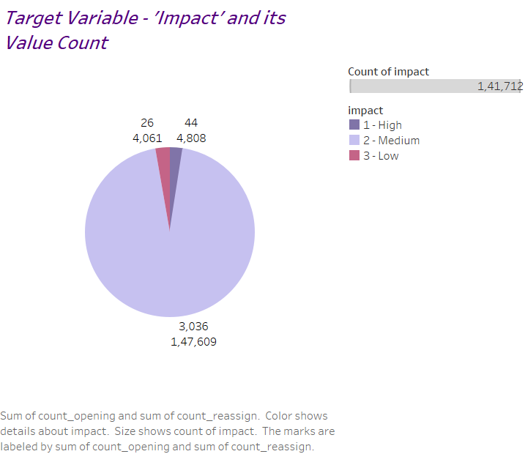
Target Variable-’impact’
As shown in graph, Impact-’Medium’ count is high in the dataset as compared to ‘High’ and ‘Low’.

Slide 9
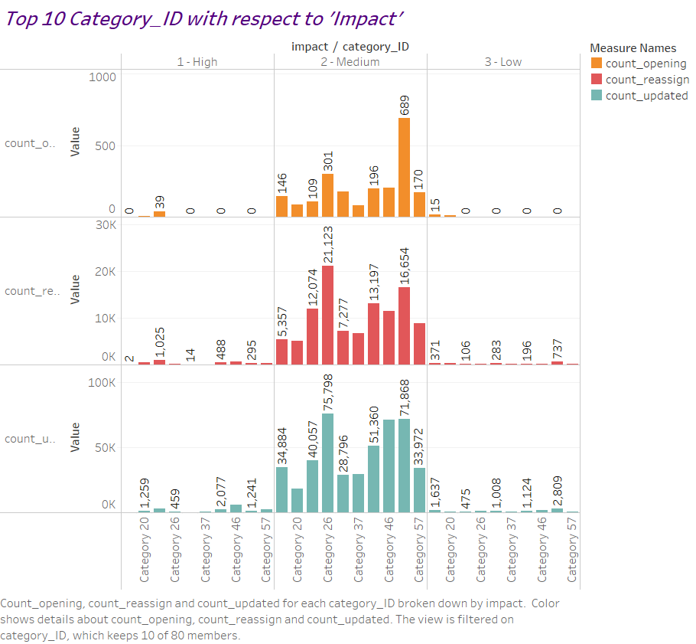
‘Category_ID’

Slide 10
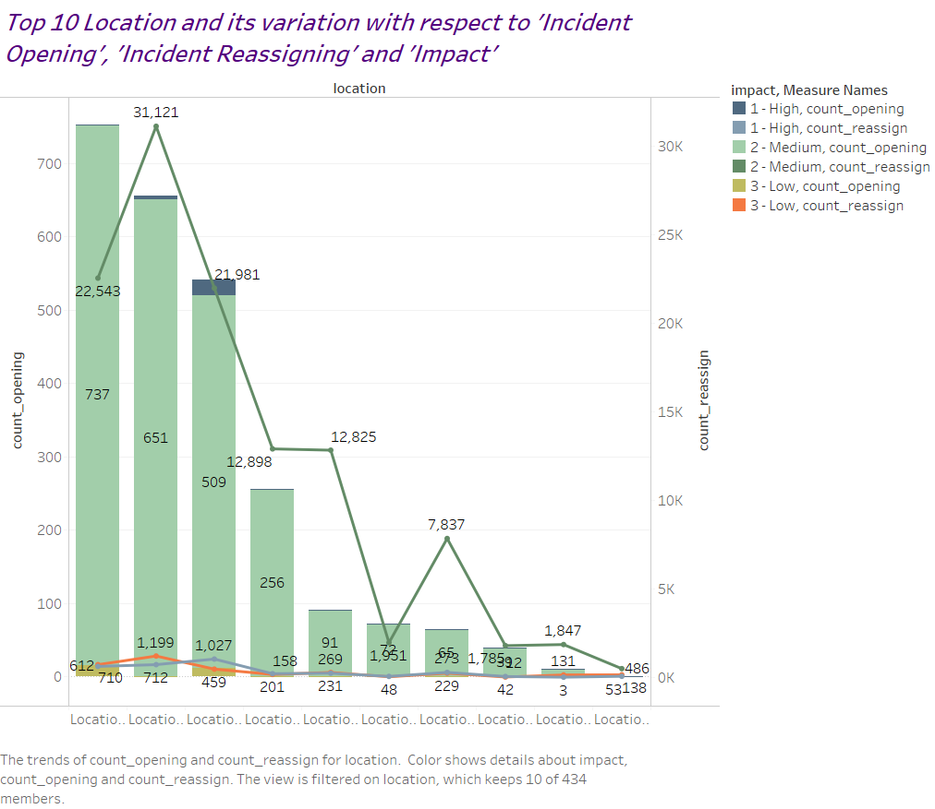
‘Location Attribute’

Slide 11
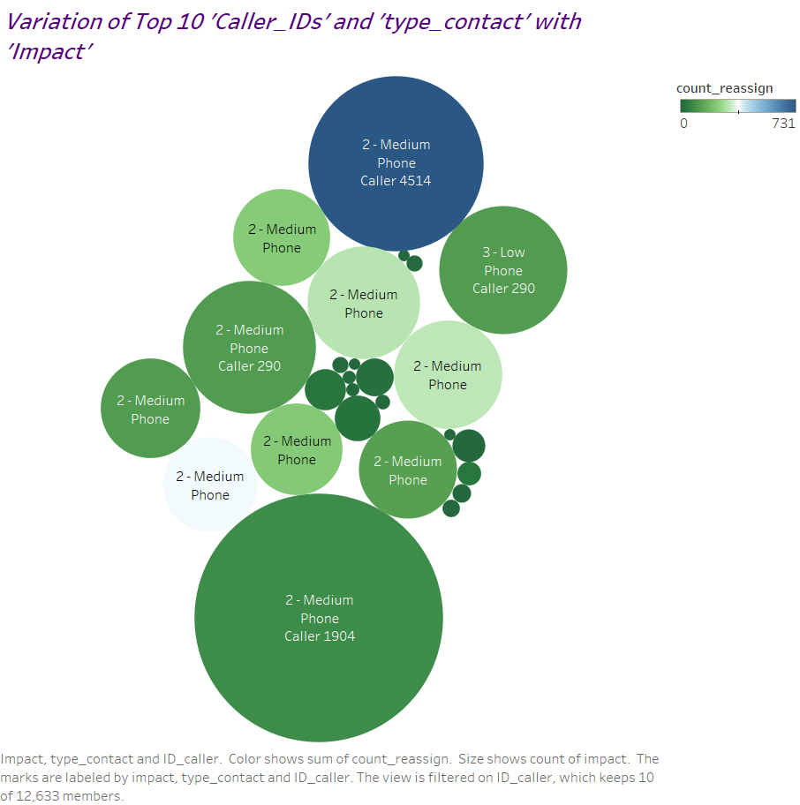
‘Caller_ID’ and ‘Type_Contact’

Slide 12
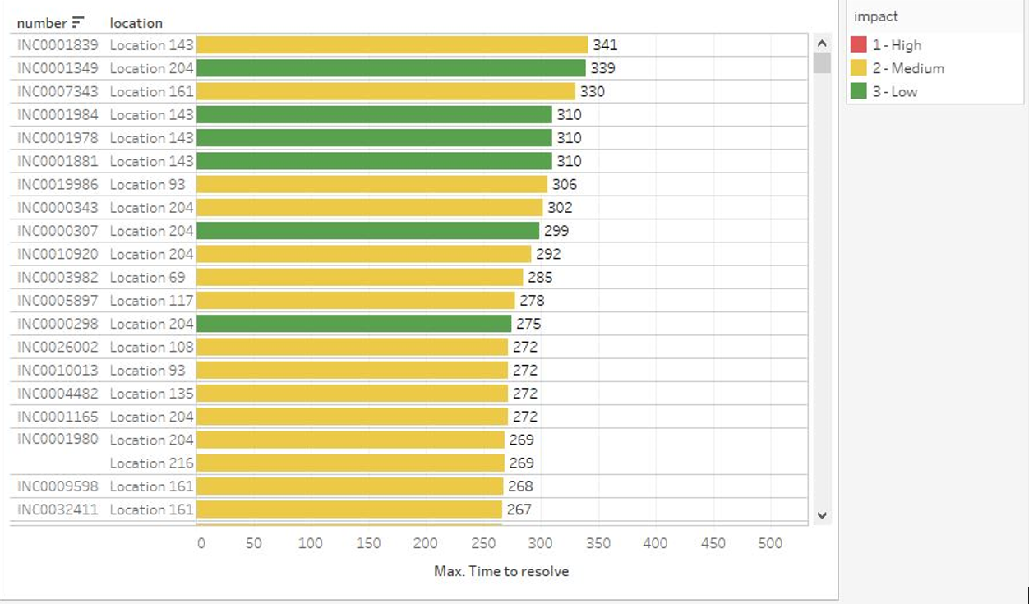
Total Number of days taken for some particular locations to resolve the issue.

Slide 13
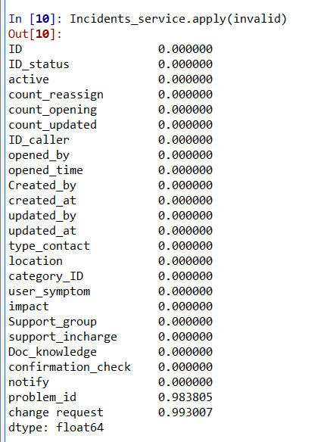
Exploratory Data Analysis (EDA)
Data Cleaning
Missing values (values are represented by “?”) only account for two columns ‘problem_id’ and ‘change request’ with 98.3% and 99.3% respectively.
Hence, I eliminated these two columns from dataset.

Slide 14
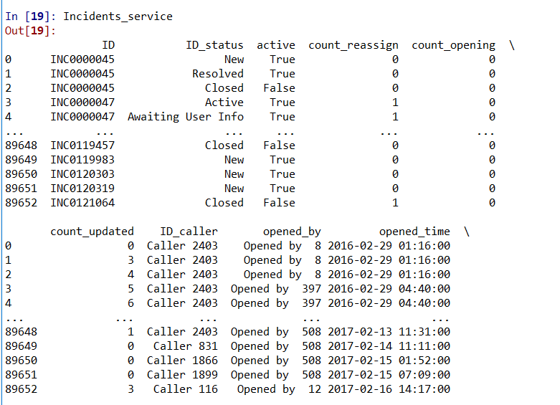
Data Cleaning (Continued)
‘ID’ column has got multiple as well as duplicate entries. Hence, I removed duplicate values w.r.t column ‘ID_status’ and ‘updated_at’
Keeping the last updated entry among duplicates, total number of rows reduced from ‘141712’ to ‘89653’.

Slide 15
Feature Engineering
Column ‘ID_status’, represents Eight levels controlling the incident management process transitions from opening until closing the case. But apart from this there are 2 entries with -100. This does not represent any particular state of the Incident. Hence, I replaced it by the ‘mode’ of the column- ‘ID_status’ i.e. ‘Resolved’ which accounts for the highest count of occurance-25004.
I checked Feature Importance and Correlation Matrix for each and every column and in accordance with that we dropped some columns.

Slide 16
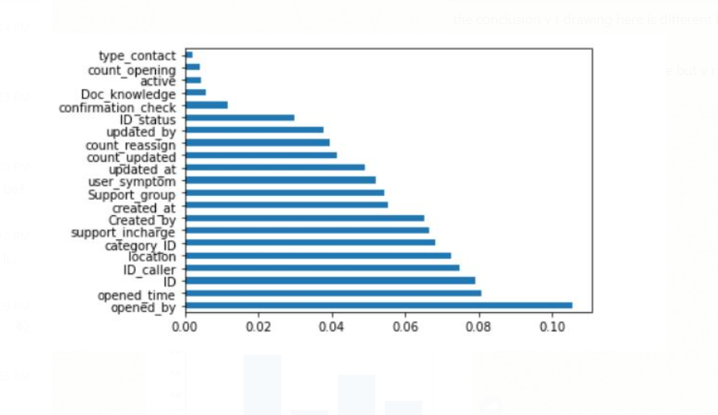
Feature Importance Graph for all the attributes in the Dataset

Slide 17
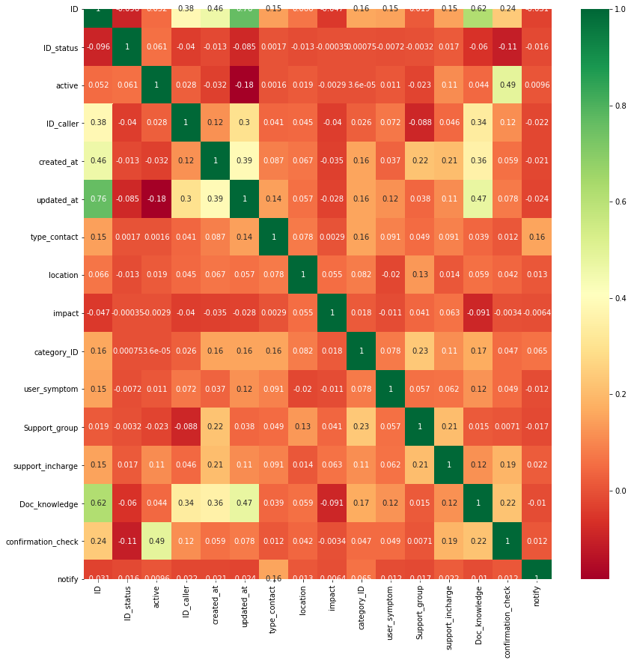
Correlation Matrix : Heatmap
As its clearly observed, many columns are showing high correlation with Target Variable and also showing inter-correlation with each other.

Slide 18
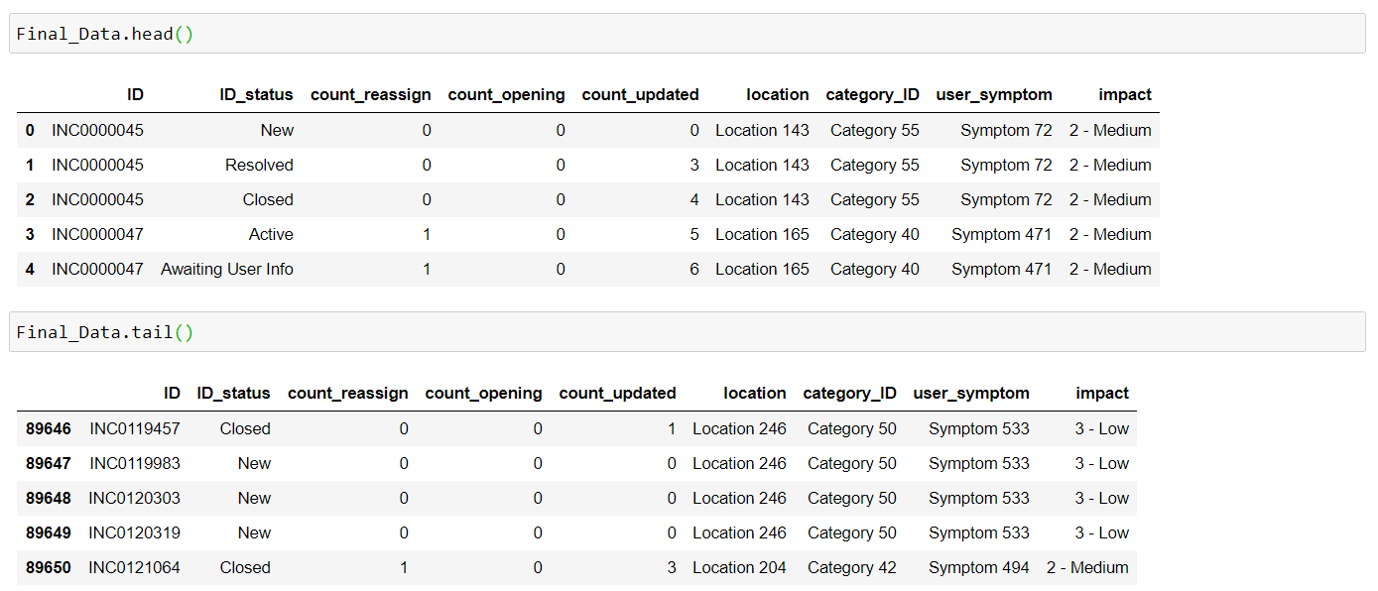
Final Dataset for Model Building
Below is the list of First and Last 5 entries of the final Dataset

Slide 19
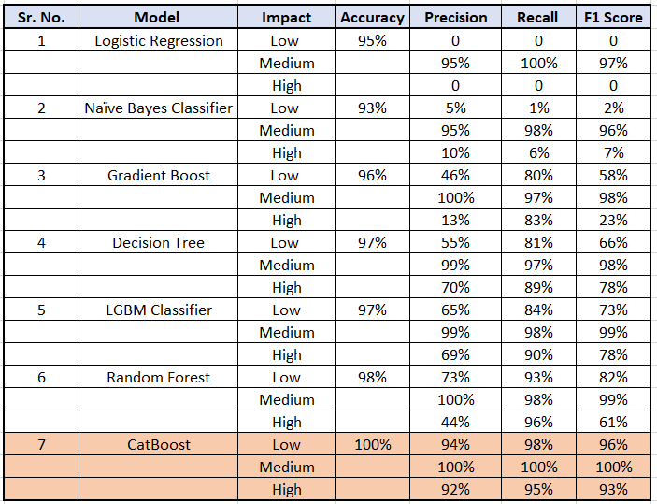
Model Building
This is the list of models I tried for this Dataset. Out of which, the best model I got is CatBoost with High Accuracy, Precision, Recall and F1 Score.

Slide 20
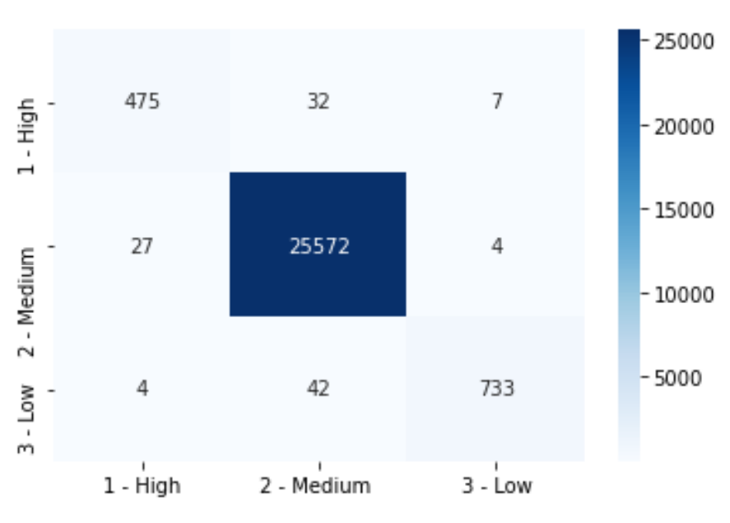
Confusion Matrix for CatBoost

Slide 21
Deployment Using Flask
For Deployment I considered only those columns which I have finalized for Model building.
For Show casing the project(model built in Python) on Local Machine I used Flask framework.
I deployed the final model on Heroku Cloud Platform.

Slide 22

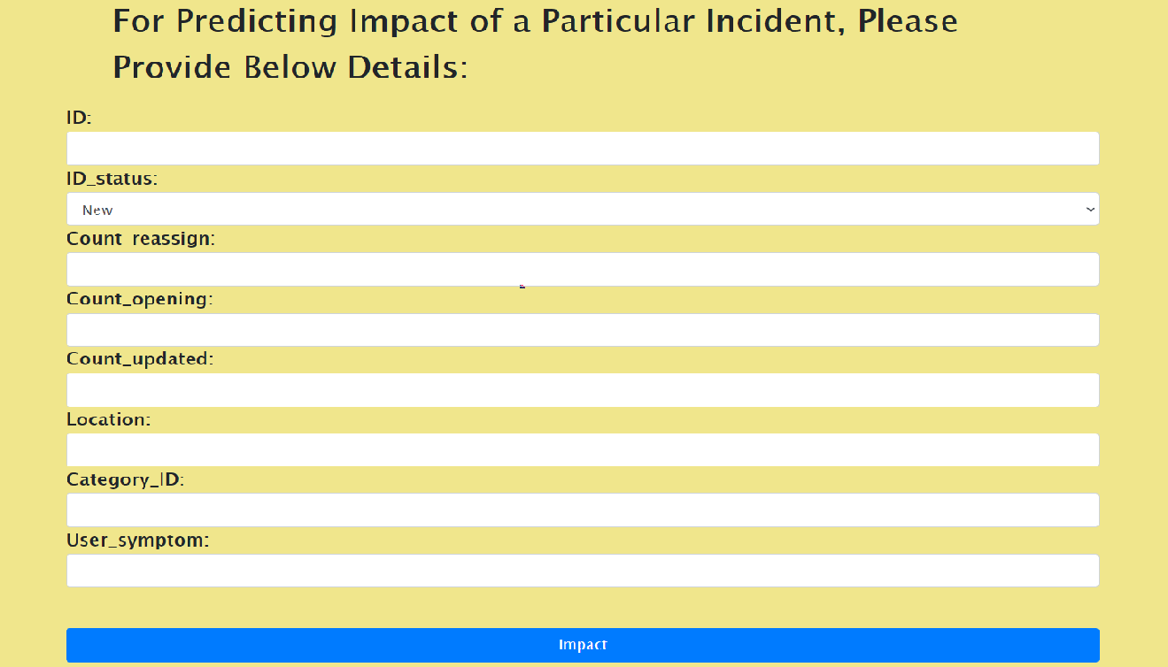
Final Deployment Page

Slide 23
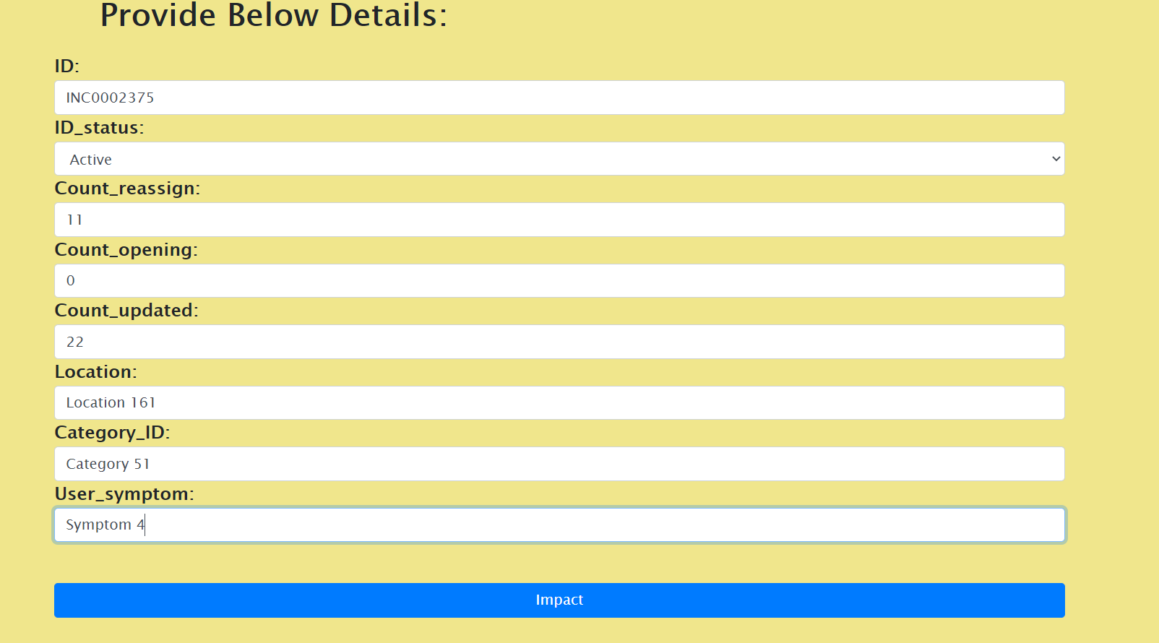
‘Impact Prediction for below Input’

Slide 24
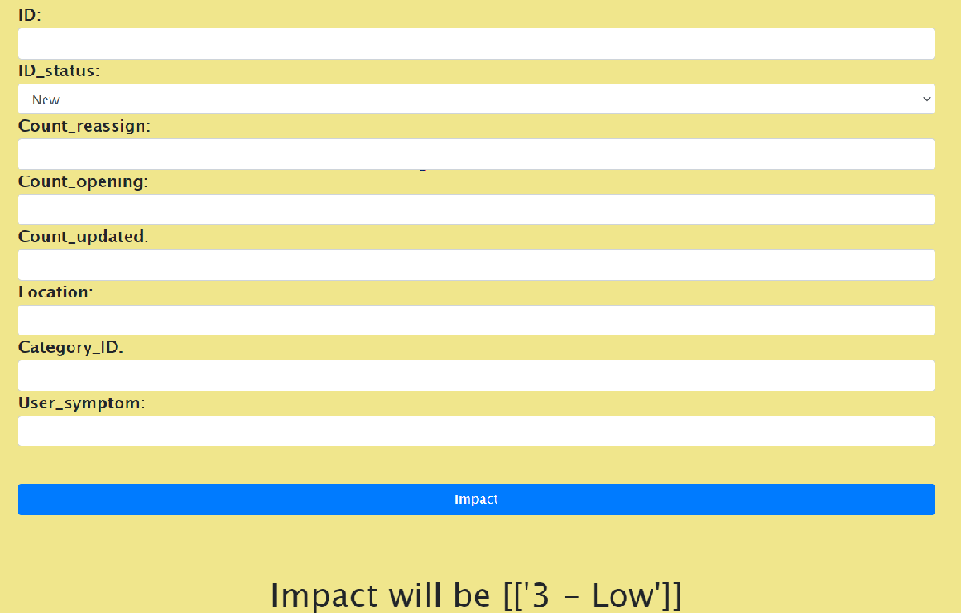
Impact Prediction Output

Slide 25
CHALLENGES FACED
1] Imbalanced data - Column Selection was a tricky task.
2] Improving precision and recall - Impact ‘Medium’ has largest value count. Hence, Precision and Recall for others (‘High’ and ‘Low’) was getting degraded for multiple models.
3] Columns had Mixed Datatypes – Lot of Transformations done on columns.
OVERCOME CHALLENGES
1] Applying different techniques for Data Cleaning and Data pre-processing we got desired results.
2] Stratified k fold Selection helped to overcome this problem.
3] Catboost eliminated multiple EDA steps of converting Categorical Data into Numerical format.

Slide 26
THANK YOU!!

